Slide 1
A Study of Traits
Lesson 9

Slide 2
Focus Question #9
SE L9-1
Is it possible for a family who all show the same version of a trait to have an individual with a different version of the trait? If so, how did that happen? If not, why not?
Notes:
BSCS focus: Models and CSW
Link to the previous lesson
Ask a participant to summarize what they learned in the previous lesson. Then ask others whether they agree and if there are other ideas they would like to add.
Participants should be able to describe that there are many different types of proteins in the body. They should also be able to say that some changes in organisms are caused by different amounts of proteins while others are caused by a changed structure of those proteins. Those changes can affect the way a protein functions.
Ask a participant to read the focus question. Ask if they can think of another example that might be interesting. Allow time write their ideas about the question. Reassure them that they are just beginning the lesson so they may not know the answer, but to write their best ideas (modeling for how they should remind students). They will have a chance to revise their ideas as they work through the rest of the lesson.
Allow some time for teams to discuss their thoughts. Ask elicit and probe questions to the groups. Encourage them to consider which ideas are similar and which ideas are different between their ideas.

Slide 3
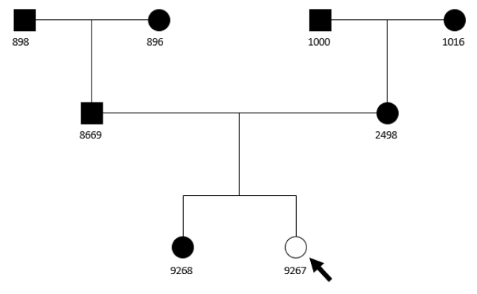
Jaguar Pedigrees
SE L9-2

Slide 4
Analyzing 9267’s Family
SE L9-3
Consider the data about Jaguar 9267 and her family. Which explanations does the data support?

Slide 5
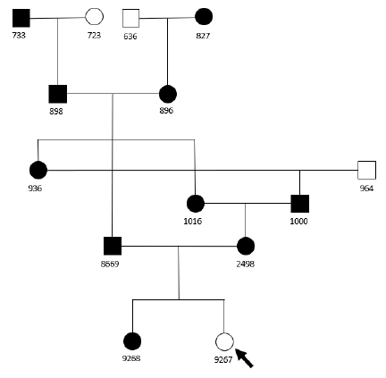
Jaguar 9267 Extended Pedigree
SE L9-4

Slide 6
Scientific Argumentation
SE L9-5
What is the role of argumentation in science?
How is scientific argumentation different from arguments you may have observed in other settings?
How is scientific argumentation similar to and different than scientific explanations?

Slide 7
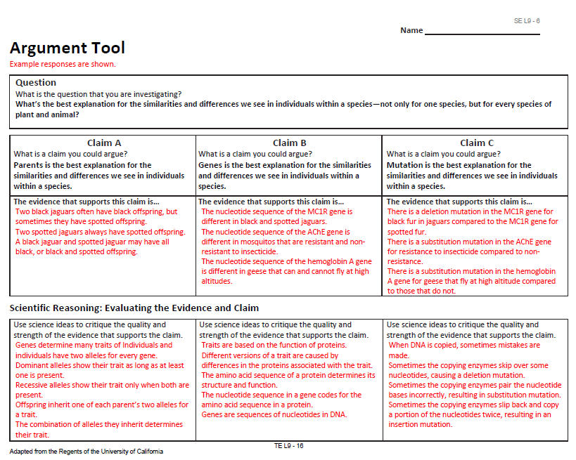
Scientific Argumentation
TE L9-16
Add page #s for the evidence. Add page #s for any additional evidence.
Add lesson #s where these science ideas are developed. Add lesson #s for any additional science ideas

Slide 8
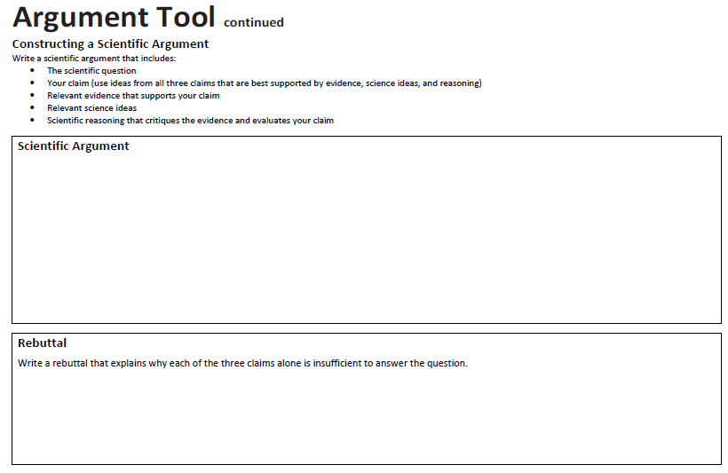
Argument Tool
SE L9-8
With your group, construct a scientific argument and rebuttal in a shared Google doc.

