Slide 1
A Study of Traits
Lesson 2

Slide 2
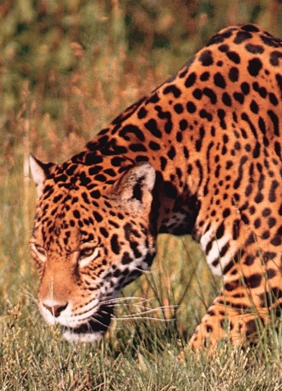
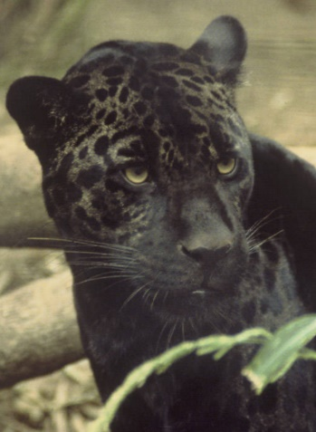
Focus Question #2
SE L2-1
What differences would you expect to find in two organisms of the same species that have different versions of a trait?
Notes:
Focus for BSCS: Elicit and Probe
Link to Previous Lesson
Remind participants that yesterday they looked at three examples of variation in different species, spotted and black jaguars, mosquitoes who are resistant to insecticides and those who are not, and geese who are able to fly at higher than average altitudes.
Review the three possible explanations for variation--the “parents” explanation, the “genes” explanation, and the “mutation” explanation--and remind participants that they decided which explanation fit best with their ideas.
Let participants know that today we will continue to explore why organisms of the same species look different from each other by looking more closely at the example of the spotted and black jaguars. We will examine some of the differences we find in the cells of the jaguar that might help us understand what is causing the differences in their fur color.
Introduce the lesson focus question: What differences would you expect to find in two organisms of the same type that have different traits?
Allow participants time to write the question and draw a box around it, then write their initial ideas below the box.
Ask participants to consider the question, What might a scientist look for and consider as they develop explanations why individuals of the same type have different traits?
Ask participants to share some of their initial ideas about what scientists might have looked for to answer the question of why organisms of the same type might have different traits.
Expected responses include:
They might have something different in their blood
They might have something different in their fur
They might have something different in the skin under their fur
The DNA in the fur cells might be different
Probe ideas briefly to clarify their initial thinking, for example,
What is this “something” you think might be different in the blood or in the fur?
How do you think the DNA might affect the fur color?
Do you think the DNA in fur cells is the same or different from the DNA in other cells?

Slide 3
Thinking Scientifically
SE L2-2
Evidence scientists might examine to look for differences to explain the variation in jaguar fur color | Explanation(s) that this evidence could support
Pedigrees (jaguars’ family trees)
Cells
Chemicals or substances in cells
Chemicals or substances in the nucleus of cells
Notes:
Setup for the Activity
Tell participants that they are going to think about what scientists might look for as they consider the origins of variation within organisms of the same type. First, put a check by any place that a scientist might look for variations. Then, write any explanations that could explain the variation in the right column. They may put an explanation name in more than one cell.
Have students discuss their ideas about where they put each possible explanation. Tell them that there is space for them to take notes about the discussion if they hear ideas that are new to them. Do not spend too long on the discussion, however, because the purpose is to get students to think about the levels of organization in a body rather than having a particular correct answer. Accept all answers that this point and do not correct students’ ideas.

Slide 4
Thinking Scientifically
SE L2-3
One scientist decided to focus on chemicals found in cells. She chose to look at the different proteins found in jaguars with different fur colors. With your partner, examine the scientist’s data about the different proteins found in 20 jaguars.
On your handout, circle the type of protein.
Use the What I See/What It Means tool to identify similarities and differences in the patterns of proteins between spotted and black jaguars.
Notes:
Distribute Protein Name and Description Handout from p. 8 of Lesson 2

Slide 5
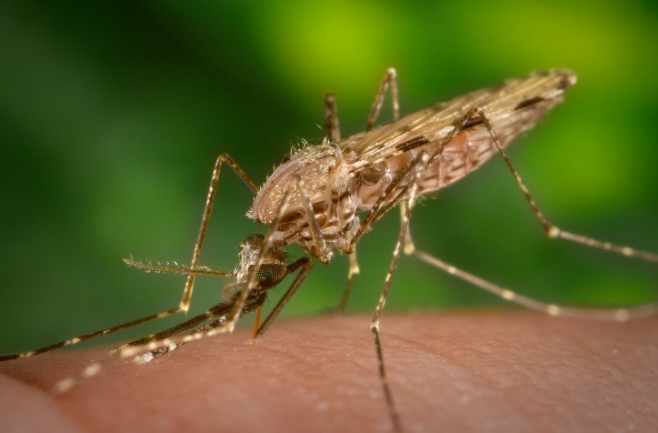
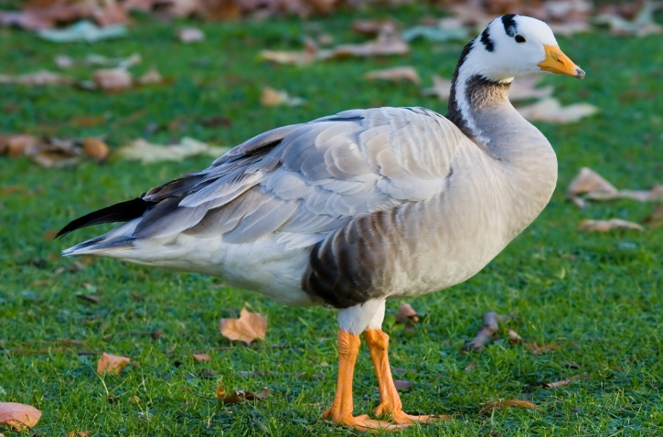
Does the Pattern Explain Other Organisms’ Differences?
SE L2-7
Notes:
Follow Up to the Activity
Participants should look back at the Variations in Organisms table from Lesson 1. They should recognize that in insecticide resistant mosquitoes, an enzyme has a change in it between the resistant and non-resistant mosquitoes. For the high altitude geese, they should see that hemoglobin, a transport protein, also has a change in it.
Lead a class discussion about these ideas. Ask an elicit question to find out whether they think that changes to other types of proteins could have effects in organisms. Probe their ideas to make sure their thinking is visible. You might ask a challenge question at this point, such as the one below, but do not try to take their thinking too far at this point in the lesson sequence.
Elicit: Do you think that changes to other types of proteins could have effects in different organisms?
S1: If actin and myosin could not work, you would not get muscle contraction. That would be bad.
Probe: What do you mean could not work?
S1: Well, if there was a change in those proteins and they could make your muscles contract. Then you could not move.
S2: Insulin is a hormone. I think some other hormones might need more regulation.
Probe: Tell me more about that.
S2: Well, we are all teenagers. I am not sure our hormones are controlled very well.
Challenge: Do you think insulin could help with that?

Slide 6
Focus Question #2
SE L2-5
What differences would you expect to find in two organisms of the same species that have different versions of a trait?
Notes:
Focus for BSCS: Elicit and Probe
Link to Previous Lesson
Remind participants that yesterday they looked at three examples of variation in different species, spotted and black jaguars, mosquitoes who are resistant to insecticides and those who are not, and geese who are able to fly at higher than average altitudes.
Review the three possible explanations for variation--the “parents” explanation, the “genes” explanation, and the “mutation” explanation--and remind participants that they decided which explanation fit best with their ideas.
Let participants know that today we will continue to explore why organisms of the same species look different from each other by looking more closely at the example of the spotted and black jaguars. We will examine some of the differences we find in the cells of the jaguar that might help us understand what is causing the differences in their fur color.
Introduce the lesson focus question: What differences would you expect to find in two organisms of the same type that have different traits?
Allow participants time to write the question and draw a box around it, then write their initial ideas below the box.
Ask participants to consider the question, What might a scientist look for and consider as they develop explanations why individuals of the same type have different traits?
Ask participants to share some of their initial ideas about what scientists might have looked for to answer the question of why organisms of the same type might have different traits.
Expected responses include:
They might have something different in their blood
They might have something different in their fur
They might have something different in the skin under their fur
The DNA in the fur cells might be different
Probe ideas briefly to clarify their initial thinking, for example,
What is this “something” you think might be different in the blood or in the fur?
How do you think the DNA might affect the fur color?
Do you think the DNA in fur cells is the same or different from the DNA in other cells?

