Slide 1
A Study of Traits
Lesson 6

Slide 2
Focus Question #6
SE L6-1
Why do two parents sometimes have children that have the same version of a trait as they do and sometimes have children with a different version of that trait?

Slide 3
Studying Jaguar Families
SE L6-2
Jaguar # | Male or Female?
1 | M
2 | M
3 | F
4 | F
5 | M
6 | F
7 | M
8 | M
9 | F
10 | F

Slide 4
Collaborating
SE L5-9
The fur color of the jaguar I am studying is ________.
The fur color of the jaguar my partner is studying is _________.
Use the Communicating in Scientific Ways stems to help you discuss ideas with your partner.

Slide 5
Studying Jaguar Families
SE L6-2
Jaguar # | Sex | Fur Color
1 | M | black
2 | M | spotted
3 | F | spotted
4 | F | black
5 | M | black
6 | F | black
7 | M | spotted
8 | M | black
9 | F | spotted
10 | F | black

Slide 6
Determining Offspring Fur Color
SE L6-3
 | Females
Males |  | 3 | 4 | 6 | 9 | 10
 | 1 | Black | Black | Black | Black | Black
 | 2 | Spotted | Black | Black | Spotted | Black
 | 5 | Spotted | Black | Black | Black | Spotted
 | 7 | Spotted | Black | Black | Spotted | Black
 | 8 | Black | Black | Black | Spotted | Black

Slide 7
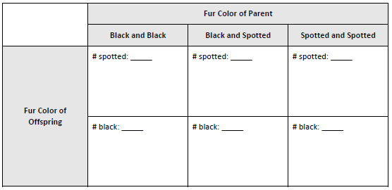
DNA and Traits
SE L6-5

Slide 8
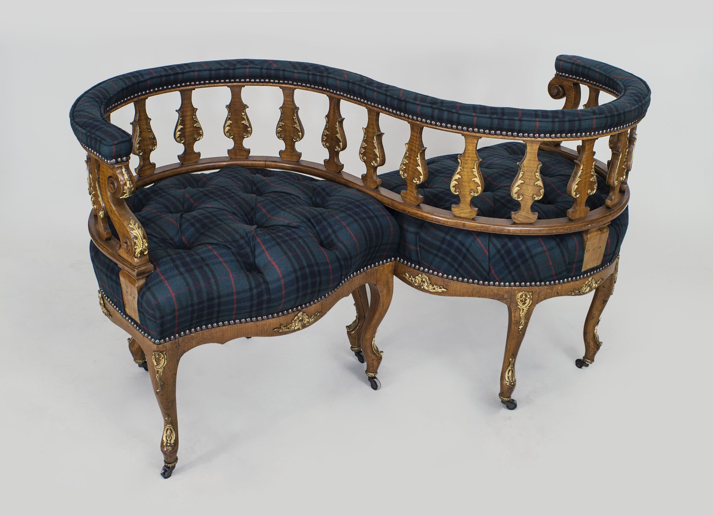
Genotype and Phenotype
SE L6-6
Use Vis-à-vis Reading to read and summarize the essay, Phenotype and Genotype.
Look back at the alleles you predicted for each jaguar offspring’s fur color. Revise your answers if needed in another color.

Slide 9
Synthesize and Summarize
SE L6-8
Based on the reading, write a paragraph that explains how two black jaguars could have an offspring with spotted fur.
Include the ideas in the box in your paragraph.
allele
phenotype
genotype
dominant
recessive
heterozygous
homozygous

Slide 10
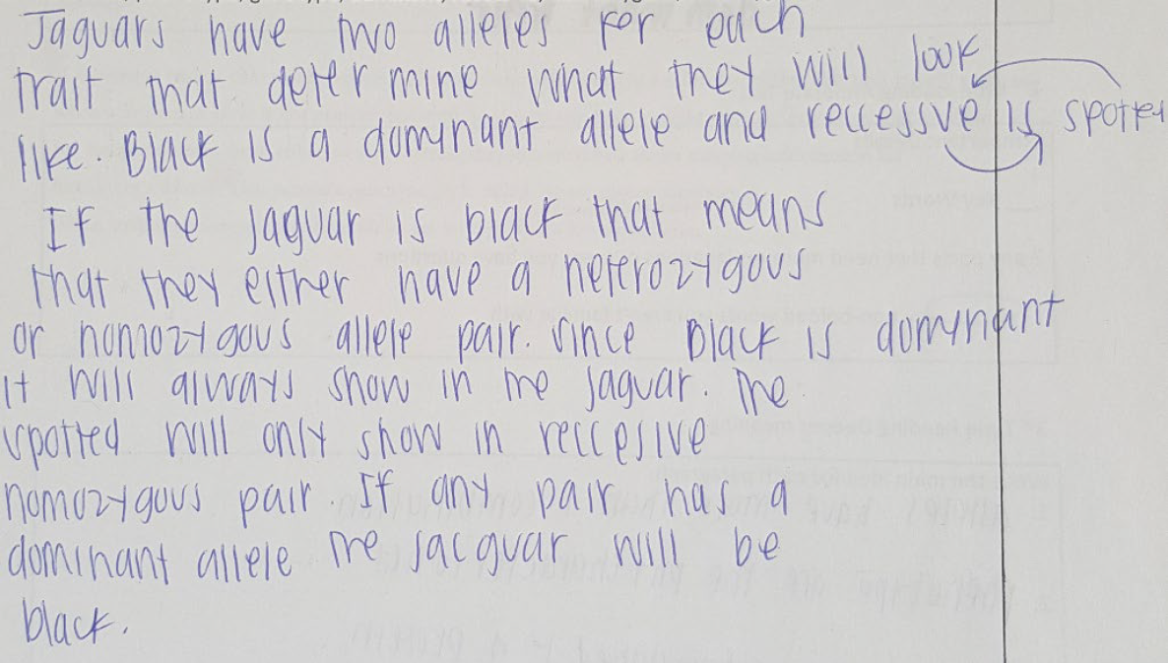
Synthesize and Summarize

Slide 11
Meta Moment
How did the model we used to study the colors of jaguar offspring help you understand inheritance in an organism?

Slide 12
Focus Question #6
SE L6-1
Why do two parents sometimes have children that have the same version of a trait as they do and sometimes have children with a different version of that trait?

